Slide 1
ASP.NET MVC CORE
Instructor: Edwin oduor

Slide 2

Quote of the day

Slide 3
Lesson objectives
Creating Relationships – One to Many

Slide 4
Lesson pre-requisites
In order to take full advantage of this section you need to have the following;
Computer with Visual Studio Installed.
Stable Network Connection.

Slide 5
Training methods and extra readings
TRAINING METHODS FOR THIS LESSON
EXTRA READINGS
Lecturing Method – This is the main method of training to be adopted in this lesson with illustrations and practical coding examples.
Discussion Method - This method will be adopted periodically whereby learning will be derived principally from the students brainstorming together, rather than from the trainer. Three main types of discussions will be used:
Directed discussion
Developmental discussion
Problem-Solving discussion
Home and Learn C#

Slide 6
relationships

Slide 7
Normally relationship means to have a connection between one another in many different ways, one can be related with another person through blood i.e. family, brother sister e.t.c,
With the same concept or thought in mind relationship between tables is an association of two or more tables in the database. This is achieved through the use of a foreign and primary key.

Slide 8
Importance of relationships

Slide 9
Through creating of relationships between tables data redundancy will be prevented or avoided – redundancy is repetition of data.
Relationships makes it possible to retrieve data from two or more tables one might think that data is coming from the same database, this is achieved through creation of joins.
Searching and filtering will be improved when using a query will be using a smaller table as compared to using a very big table.

Slide 10
types of relationships

Slide 11
One to One relationship. – an example of this relationship is an organization can decide that a department is headed by one person, therefore this is going to be a one to one relationship because one employee is heading a department. Another example a country only has one capital city.
One to Many relationship – Many students can enroll in one course or one course can be enrolled by many students.
Many to Many relationship – This is a kind of relation where multiple records in one table can relate with multiple records in another table. i.e. customers can purchase many products and many products can be purchased by many customers.

Slide 12
Adding a model

Slide 13
To create relationships we need to have another table because currently we have one table.
Will create a folder inside model and give it the name course.
Inside the folder will create a class and call it course, the class will have two fields CourseId and CourseName.
In the folder created (course) will have a class course, Interface ICourseRepository and Another class Course Repository that will implement the interface (ICourseRepository)

Slide 14
Exercise

Slide 15
In the folder created (course) create a class course, Interface ICourseRepository and Another class Course Repository that will implement the interface (ICourseRepository).
The interface should have the following methods
GetRegister
GetAllRegister
Add
Update
Delete
Add a migration give it an appropriate name, then update the database.

Slide 16
creating relationships

Slide 17
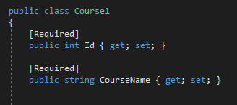
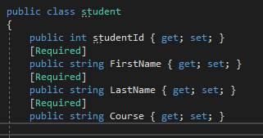
To create relationships we need the two tables. In our case we have students and courses tables.

Slide 18
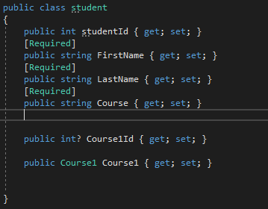
The relationship that we will create is one to many relationship because many students can enroll in one course or one course can be enrolled by many students.

Slide 19
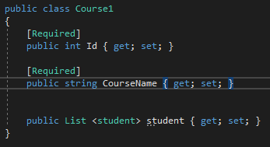
This is the course table in the course table we are creating a relationship to show that many students can enroll in one course. And then in the student table we are adding courseId as the foreign key and the last method is to tell that we are relating the student table with the course table.
Once this has been done we need to add a migration and give it a name based on what we are doing. Then update the database. When this is done the changes are going to be affected and the relationship between the tables will be created.

Slide 20
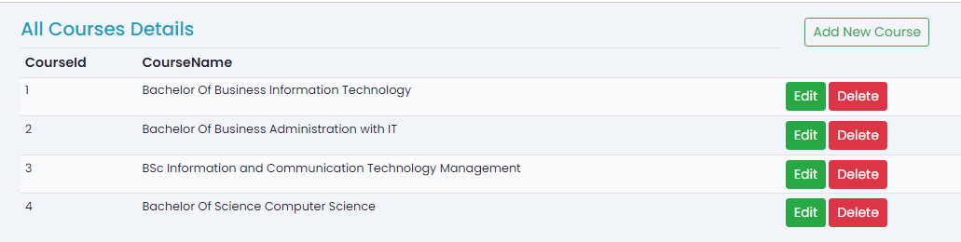
After the migration is done and everything is ok, create a controller and view, the final output should look like the one shown below.

